Slide 1
Hide and Shoot
Steve Rabin
03.20.2018

Slide 2
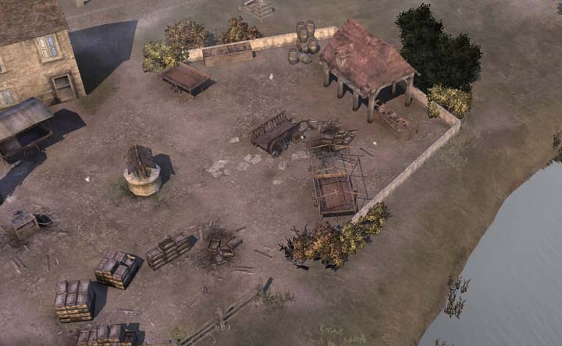

Slide 3
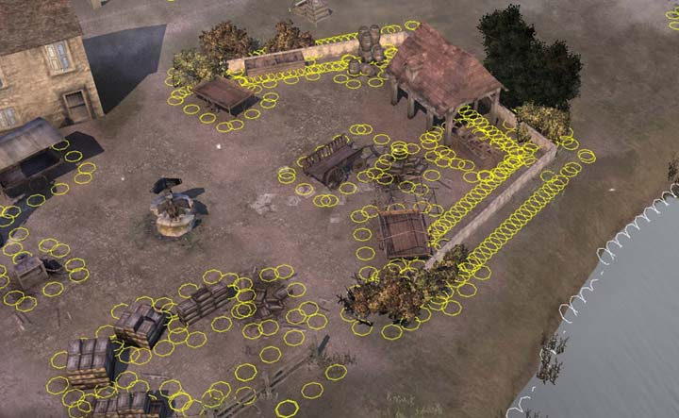

Slide 4
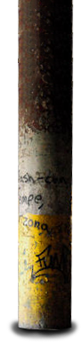
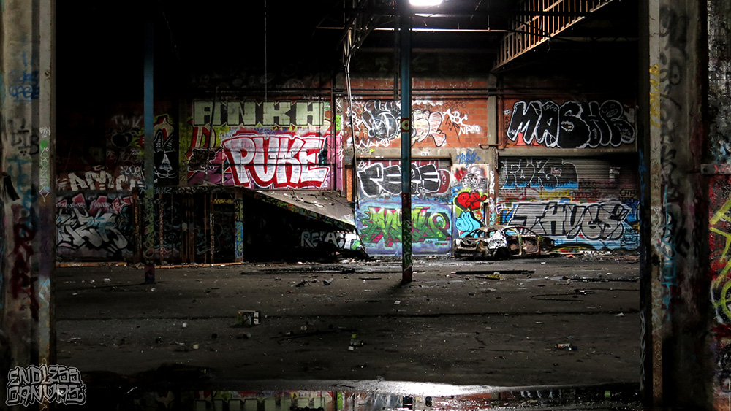
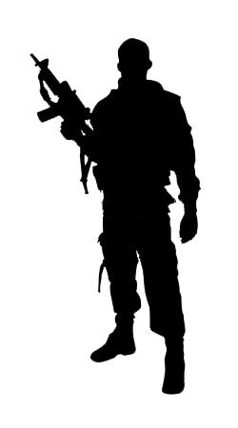
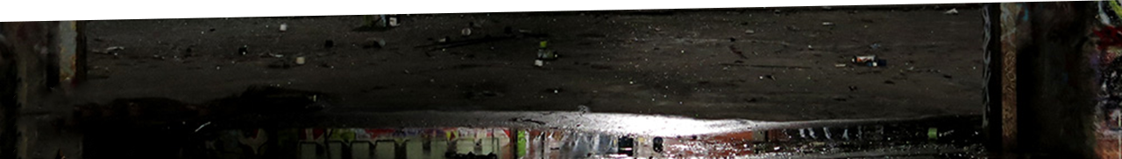
Photographer: Madeleine Tonzi

Slide 6
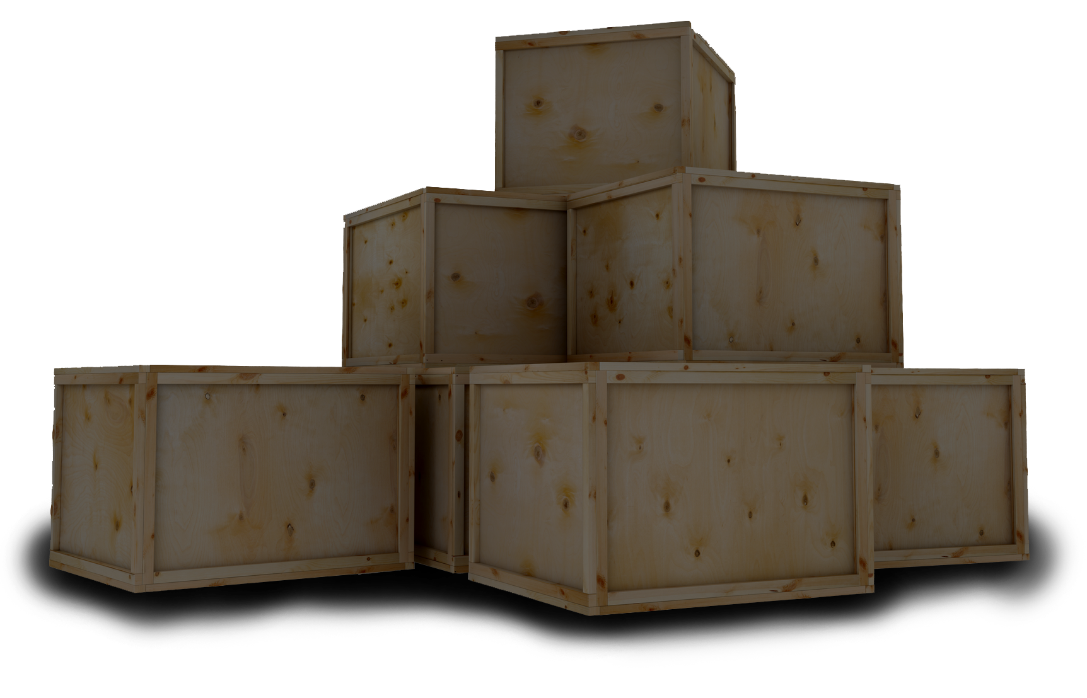

Slide 8
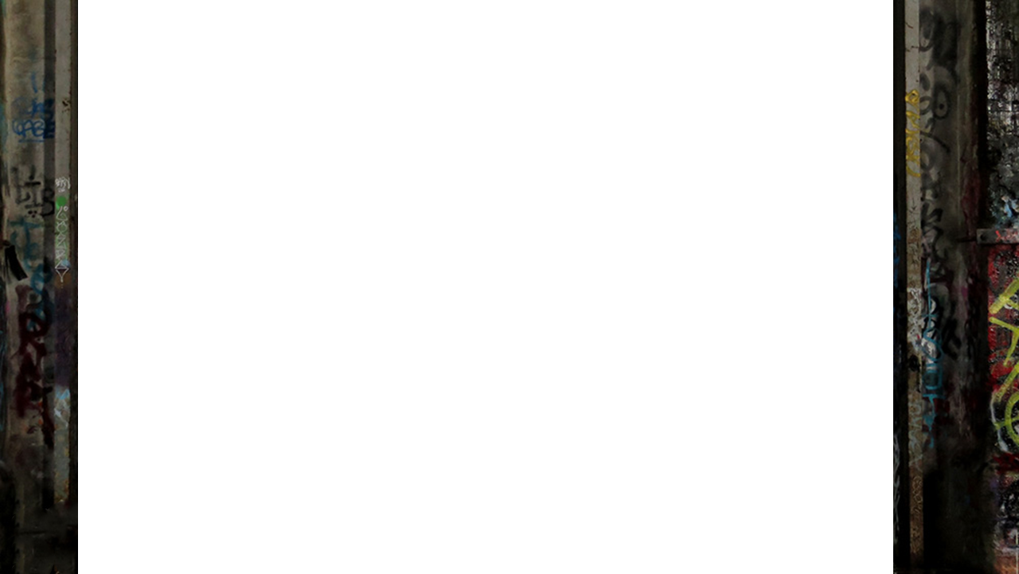

Slide 25
Notes:
Only take those with 2 points.

Slide 26
Sampling Strategy
Uniform
Jitter
Poisson Disc
BETTER QUALITY

Slide 27
Sampling Strategy
Uniform
Jitter
Poisson Disc
BETTER QUALITY

Slide 28
Sampling Strategy

Slide 29
Thanks!
Steve Rabin steve.rabin@gmail.com

